Slide 1



Slide 2
^{Passive Income – Noun}
Relating to business activity in which the owner does not actively participate in the generation of income.
^{Buff – Noun}
A temporary improvement of a specific statistic or trait of oneself.
^{Passive Income Buff – Noun}
An improvement in the rate of one’s earnings that requires minimal engagement to start and no upkeep while its active.

Slide 3
What is Passive Buff?
Passive Buff is a data rewards tool designed to help influencers monetize and reward their audiences with minimal effort.
Using Datalucent’s patented data sharing technology, audiences can safely and securely share their data with brands.
By sharing data, audiences earn rewards for themselves, and support the influencers they love.

Slide 4
Why consumer data?
Due to changes in privacy laws, consumer data can no longer be purchased or used without their knowledge and consent.
Brands still seek data but don’t want to upset their customers who are increasingly sensitive towards privacy issues.
Passive Buff provides a safe and secure environment for sharing data that brands and consumers can trust.

Slide 5
Consumers Are in Control
Passive Buff facilitates the relationship between the consumer and the brand and does not own any data.
Consumers always own their data and can ask for it to be removed from our systems at any time through Datalucent’s Delete API.
Most consumers are unaware they own their data or that they can be rewarded for it.

Slide 6
Consumer Incentives
In our typical campaign, consumers are given a gift card (such as a $5 Amazon.com Gift Card) as a sign up bonus for providing their Facebook or Twitter data file.
They are provided additional rewards each time they consent to allowing a company to use their data.

Slide 7
Content Creator Benefits
Content creators are excellent ambassadors for new ideas and can help educate consumers about their data rights.
DataLucent provides payouts to content creators on a per-user basis for educating consumers that sign up for DataLucent Rewards.
Our typical campaign pays $5 in cash to the influencer for each user that signs up using a code we provide to the influencer.

Slide 8
Summary
Consumers are provided a $5 Amazon.com Gift Card for signing up and submitting a valid Facebook or Twitter file.
Influencers are paid $5 for each user that signs up and uses their unique code.
Consumers and influencers can earn additional rewards each time a user consents to a brand using their data.

Slide 9
Consumer Experience
Datalucent Technology Walkthrough

Slide 10

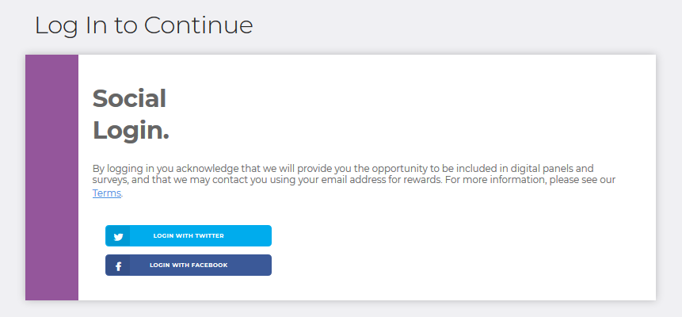
Social Login
The user can choose the social media outlet they prefer.
Logging in is an acknowledgement and agreement to Terms & Conditions.

Slide 11
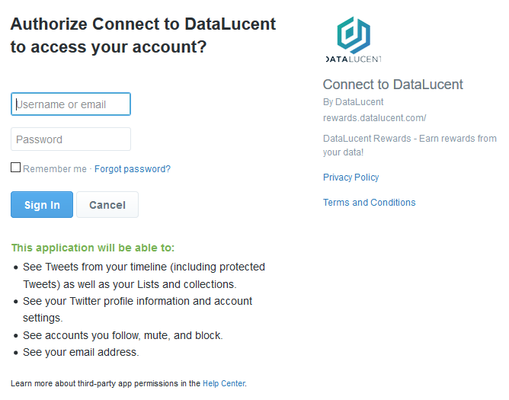
Grant Approval to Connect
After the user chooses which social outlet they prefer, they will be prompted by the social outlet to approve the connection.
To the right is Twitter’s login approval page. This is standard for social logins throughout the web.
If the user is already logged in to the social media outlet on their device, they do not have to enter their username and password again.

Slide 12

File Request
Twitter
After logging in to the social media outlet of their choice, the user is directed towards instructions on how to acquire their data.
This typically involves visiting the settings or privacy page of their social media account and requesting a copy of their data.
Once the request is entered, the user must wait for their file to become available.
Some requests are instant while others can take 24 hours; this depends largely on how much media (photos/vidoes) the user has in their social media profiles.
Facebook

Slide 13
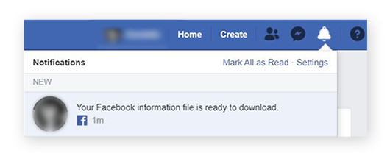
File Ready Push Notification
All social media outlets will send a push notification to the user when their file is ready.
Depending on the user’s settings, the notification may also display on their phone.
They can also be reminded through email from DataLucent to check for their file.

Slide 14
File Download
Twitter
Once the user receives a push notification that their file is ready, they are prompted to return to the page on the social media outlet where they requested the file.
Once there, the user then enters in their password, clicks download, and is prompted by their device to download the file.
Each device has a unique download prompt, but all of them work the same way: the file is placed in a downloads folder.
Facebook

Slide 15
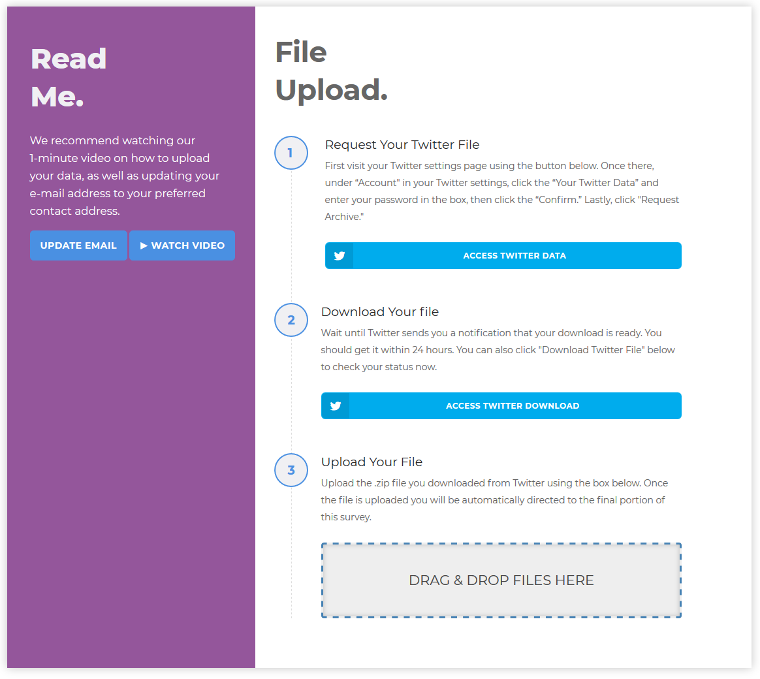
File Upload
Once the file is downloaded, the user returns to the DataLucent upload page and uploads their file.
The user can update their email address to their preferred contact email, and a one-minute YouTube tutorial is provided.
Our upload process is resilient and can resume if the device is locked or goes into standby.

Slide 16
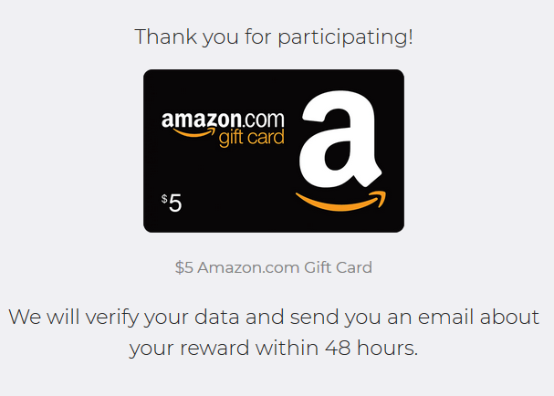
Prize Page
At this point the process is completed and the user awaits their prize.
DataLucent checks the data for validity and the reward is sent to the user within 48 hours.

Slide 17
Backend Data Review
DataLucent receives the files in a storage bucket to review them for validity.
Users with valid files receive their incentive through the email provided during the upload process.
Validity entails:
Active account (recent activity)
Older account (not just created).
Appropriate data indicators (not a bot or fake account).
Other datapoints depending on the social outlet.

Slide 18

Contact
To join Passive Buff or for more information please email chris@datalucent.com.
Thank you!

